Slide 1
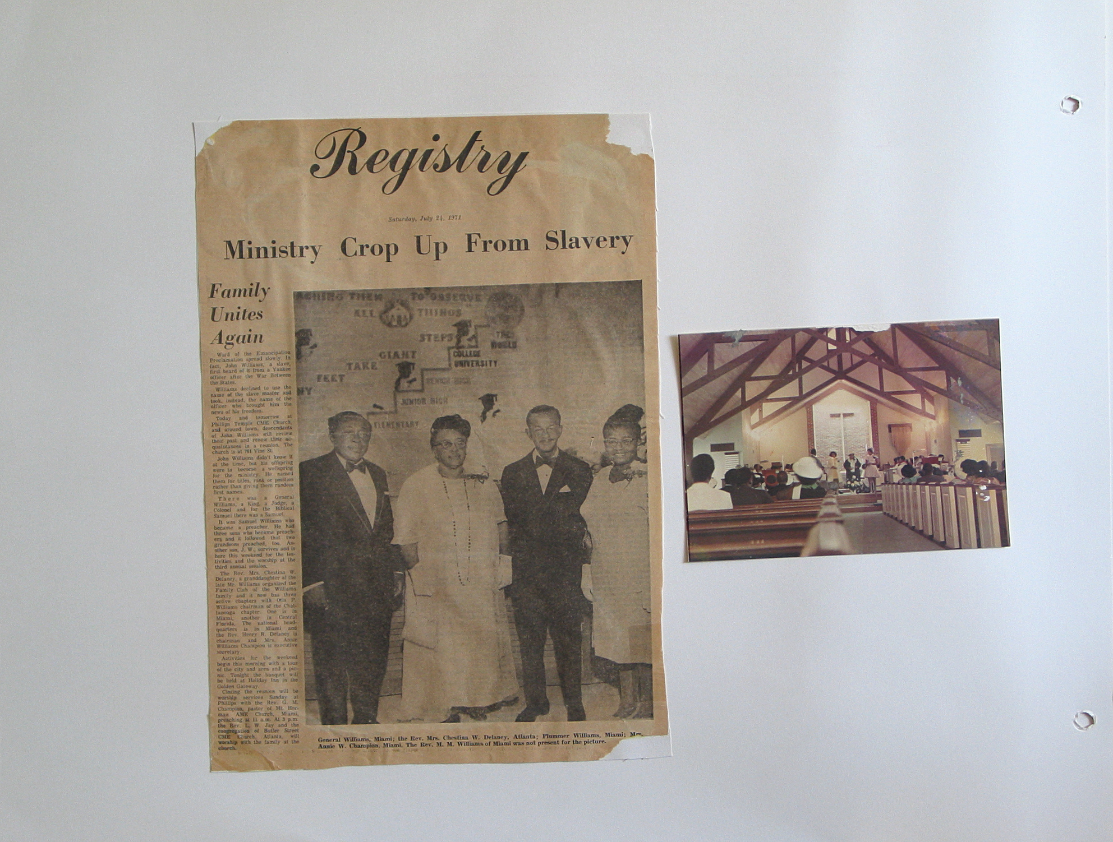

ROOTS & FRUITS
The Williams Family Legacy - Reclaiming Our Narrative: Celebrating Our Past, Present, and Charting Our Future
A journey through time, tracing our family's remarkable path from the horrors of slavery to the founding of a lasting family institution that spans generations.
Notes:
1

Slide 2

Patriarchal Root:
John Williams' Journey
1
1850
Six-year-old West African boy abducted from his village and survived the "middle passage"
2
1865
At age 21, freed from slavery by Union Lieutenant Williams, whose name he adopted
3
1875
At age 31, married Patsy Murray (daughter of Cherokee mother Comfort and raised by John Robinson)
4
1929
Passed away at age 85 after a life as a successful farmer and horse breeder
Notes:
2

Slide 3
The First Family Union: John & Patsy
John and Patsy Williams built a strong foundation for our family legacy. John was never a sharecropper but leased his land from the Neel brothers in Thomasville, Georgia. As a successful farmer and horse breeder, he provided for his growing family despite losing a leg to gangrene after stepping on a rusty nail.
John & Patsy's Children
  Colonel Williams
  Chestina Williams Robinson Hayes
  Mary Jane Williams Hunter Livingston
  Judge Williams
  Arthur Williams (died young)
Together, they had nine children between 1871 and 1891, establishing the first branch of our family tree. Tragically, Patsy died in 1894 of unknown causes, possibly from a Yellow Fever outbreak or plague that followed US trade routes in the 1890s.
  Rev. Samuel "Lovelace" Williams
  Callie Williams (died at five)
Notes:
3

Slide 4
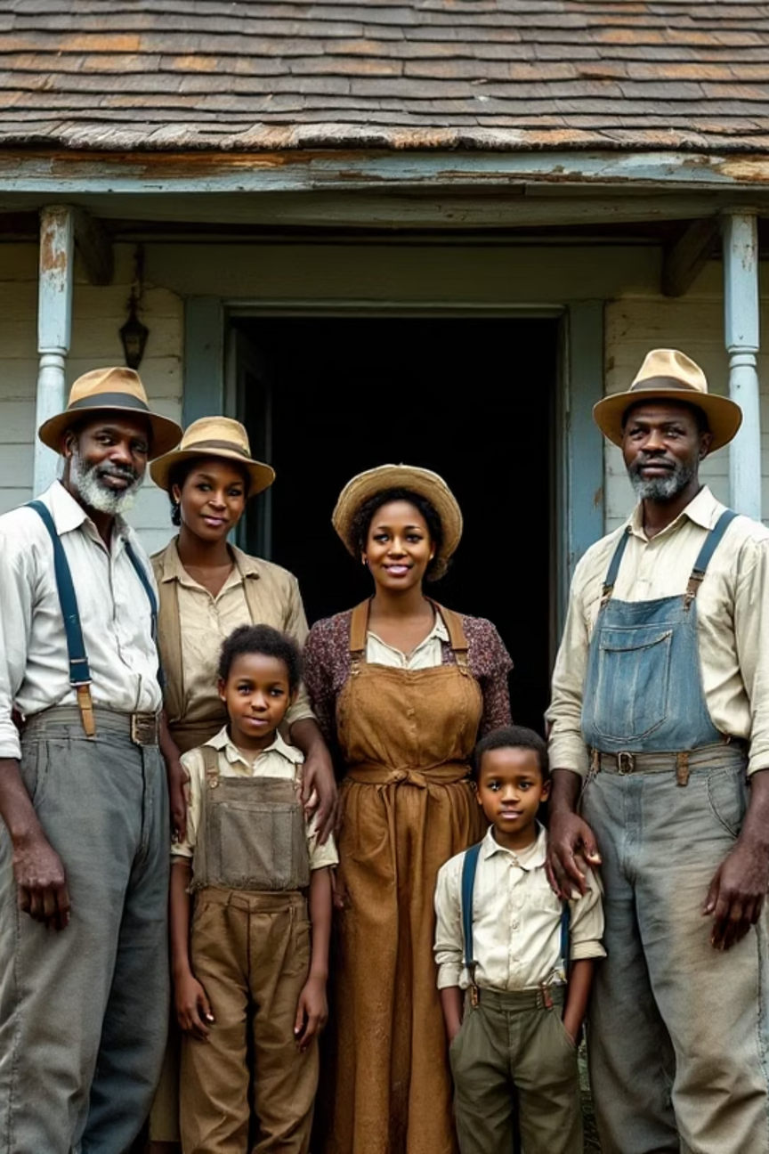
The Extended Family:
Alex & Jennie
Patsy's brother Alex Farmer married Jennie Patton on March 5, 1880. Jennie was born in 1856 to Silva Patton of Tennessee, with her father unknown. The families lived near one another as farmers, creating a close-knit community.
Alex & Jennie's Children
  Eddie Farmer
  Cicero Farmer
  Homer Farmer
  Ellis Farmer
  Victoria Farmer Hadley
Alex and Jennie had seven children between 1872 and 1892 (some born before their marriage). Sadly, Alex died not long after his sister Patsy, possibly from the same outbreak that claimed her life.
  Idella Farmer
  Dr. Alexander Alphonso Farmer
Notes:
4

Slide 5
The Family Grows Again:
John & Jennie
John & Jennie's Children
  Lula Williams Hardy
  Beatrice "Tiny" Williams Dunaway
  Deacon John "Bud" Wesley Williams
Jennie was a midwife for 20 years, a proud member of Mt. Herman Lodge No. 3517 Grand United Order of Odd Fellows, and known as a strict disciplinarian.
After John's death in 1929, Jennie lived with her daughter Victoria rather than her son Dr. Alexander Alphonso Farmer, whose wife opposed the arrangement due to colorism - believing Jennie's dark skin would impede their rise in black bourgeois society.
Notes:
4

Slide 6








The "Double Kin" Connection
John & Patsy
Patsy & Alex
1875:
Original marriage established first branch of family
Siblings who maintained close family ties
John & Jennie
Alex & Jennie
After deaths of Patsy and Alex, John married Jennie (December 18, 1895), creating "double kin" relationship
1880: Marriage established second branch of family
To survive hard times, John and Jennie married in 1895, making Alex and Jennie's children both John's nieces/nephews and step-children. This created what we call "double kin" - a dual kinship that strengthened family bonds.
Notes:
5

Slide 7
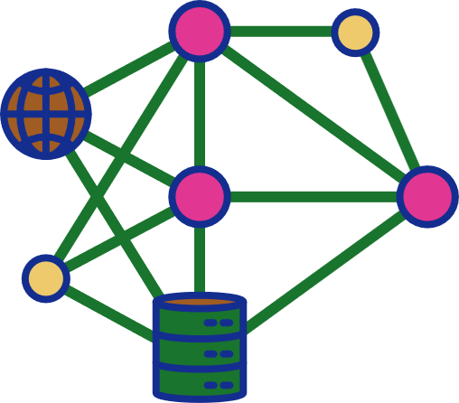
Complex Family Dynamics
John & Liza's Children
During both marriages, John maintained a relationship with neighbor Liza Baker, which produced:
  Pinky Williams Peterman (1880)
  Queen Ann Belle Williams (March 27, 1886)
John briefly separated from Jennie and married Liza on January 4, 1898 (becoming a bigamist), but reconciled with Jennie by 1890.
Notes:
6

Slide 8

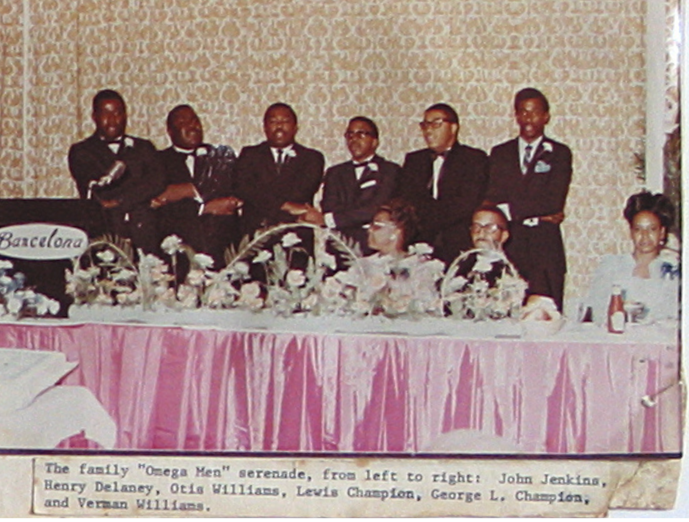

The Fruit: Family Achievements
Civil Rights
Public Service
Family members participated in every major and minor movement to improve lives: civil rights, women's suffrage, educational, vocational, pay equity, and feminist causes.
Proud veterans of every branch of government and civil servants.
Multiple political leaders, both appointed and elected.
Spiritual Leadership
A plethora of spiritual leaders and ministers excelling in the pulpit, administration, education, music, and financial stewardship.
As time progressed, family members moved and opportunities opened for colored people, negros, blacks, and African Americans throughout the US and around the world. Our family seized these opportunities, but success led to geographic dispersion.
Notes:
7

Slide 9

The Challenge:
Family Disconnection
Despite our family's remarkable achievements across many fields, success led to an unintended consequence: family members drifted apart geographically and socially. The situation became so severe that first cousins no longer knew one another.
The Wake-Up Call
"The children of her brothers started dating, not knowing they were first cousins. When word made its way around the family, there was shock, outrage, and then action."
This disconnection reached a critical point when children of siblings began dating, not realizing they were first cousins. When this news spread through the family, it caused shock and outrage, but ultimately led to action.
Notes:
8

Slide 10
55 Years of Family Unity
55
35-220
1969
Years of Reunions
Attendance Range
Founding Year
Annual gatherings since 1969 (except 2020 during COVID-19)
Family gathering size has fluctuated over the decades
When the Williams Family Club was established
"Our most uttermost concern: a spiritual uplift together. Where we gather, when we gather, how we gather is secondary to the fact that we DO GATHER TOGETHER in love."
The Williams Family Club continues to thrive with established branches, rotating host cities, and blossoming membership. Even during the 2020 pandemic, we maintained connection through Zoom calls and small gatherings, demonstrating our commitment to family unity.
Notes:
10

Slide 11
